Slide 1
Autonomous Drone Delivery System for Industry 4.0
Progress Report
Student Name: Jianhui Li
Supervised by: Dr. Tengyuan Zhang & Prof. Jun Yang
Submission Date: June 15st, 2018

Slide 2
Progress
Learning objective-c from udemy and youtube
Using Mobile SDK, and build an APP control the drone
Develop Onboard SDK with Raspberry PI
Use c++ writing code and debug in linux
Successfully communicate with M100 by using Raspberry PI

Slide 3
Objectives
Know and learn how to control the drone through Onboard SDK
Build an APP which can send order to M100

Slide 4
Reading/Literature Review
If you did any reading/literature review in the past two weeks, then:
DJI onboard SDK tutorial
Udemy: Linux beginner
DJI onboard API: https://developer.dji.com/onboard-api-reference/index.html
Linux org tutorial

Slide 5
Current Challenges/Discussion
Using Linux system is the main challenge, and also setup a new raspberry pi. It is the first time for me to use linux system, which has a huge difference compared to windows and macos. And communication between drone and raspbeery is another challenge.

Slide 6
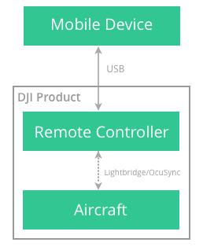
Lab 1: test communication between mobile and M100
Introduction:
The drone m100 supplies API to for mobile to use SDK function to send order. The mobile needs to connect the remote controller to achieve its function

Slide 7
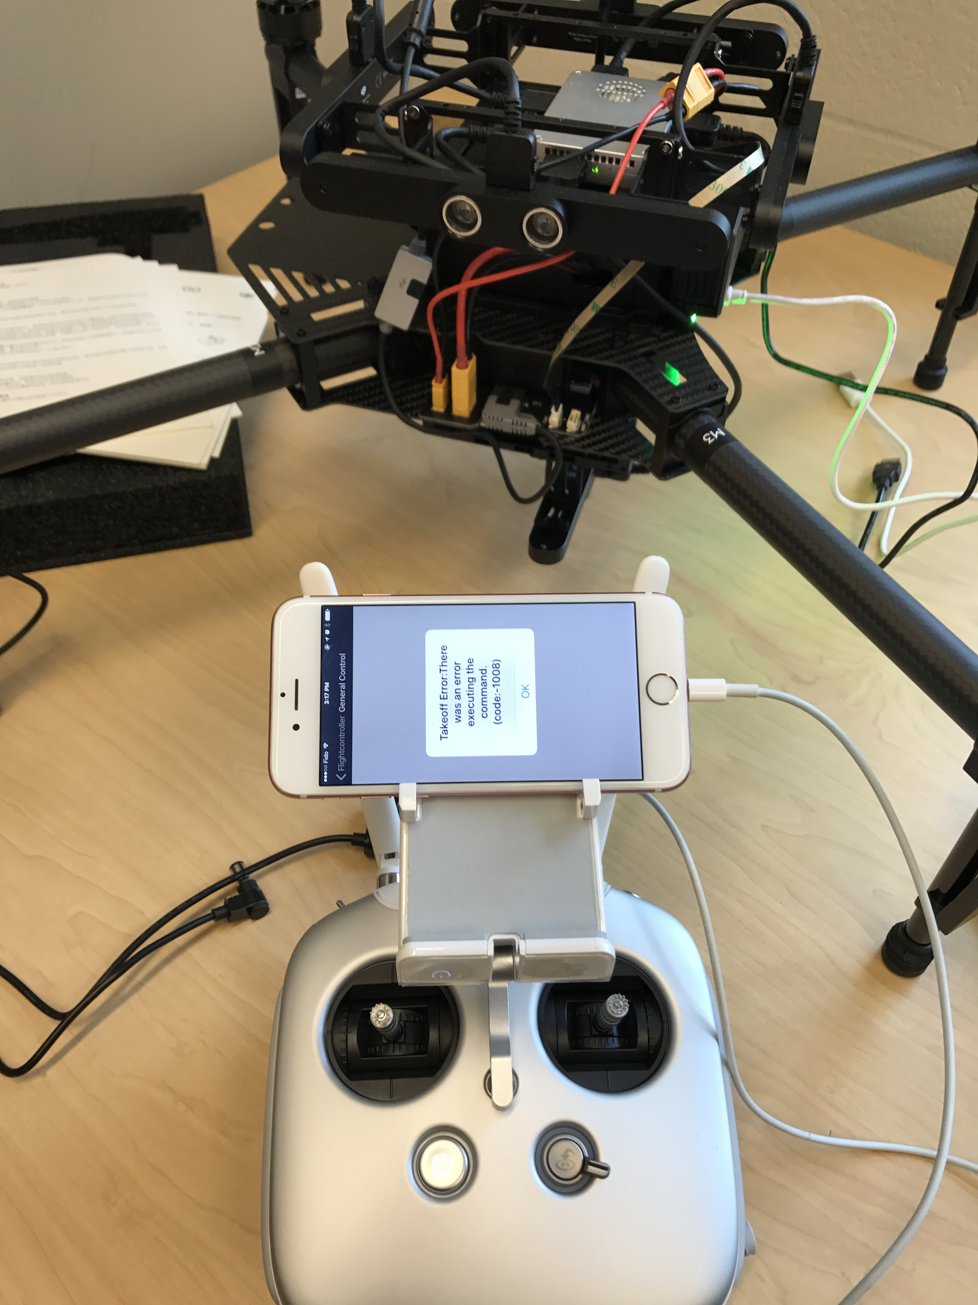
Progress:
Prepare the objective-c coding, and SDK APP key.
Upload the code into mobile iPhone 6s.
Turn on the devices
Send order turn on the motor.
M100 motor rotate

Slide 8
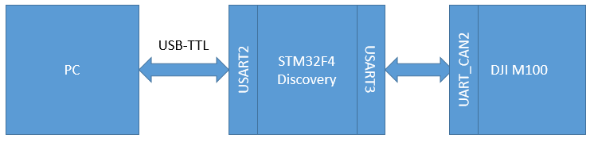
Lab 2: test communication between mobile and M100
Introduction:
The drone m100 supplies API to for linux, qt, ros or stm32 to use onboard SDK function to control the drone. In this project, Raspberry Pi is used as the controller board.
Raspberry Pi

Slide 9
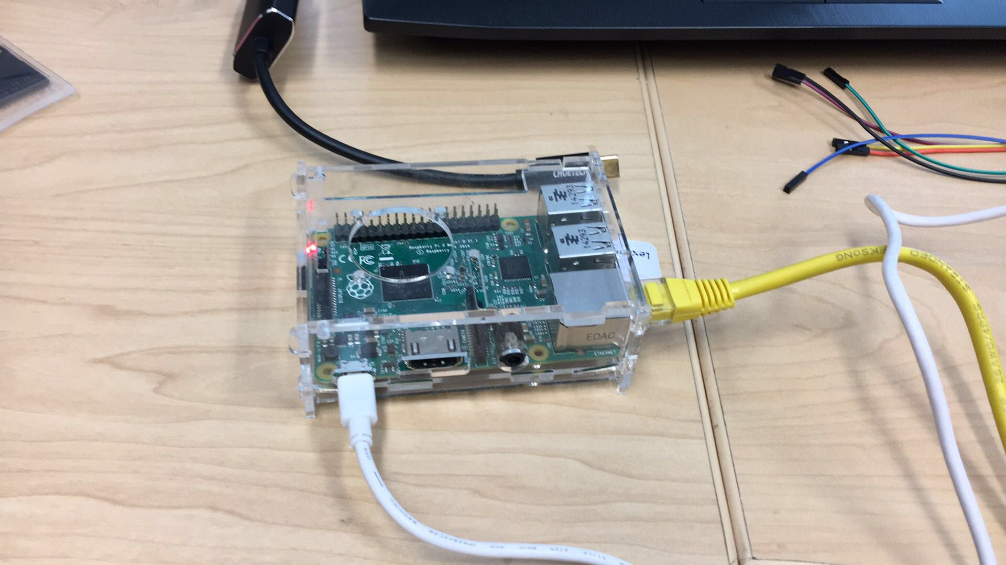
Progress 1:
Connect Raspberry Pi to laptop
Upload linux system into Rpi
Install c++ IDE to write code

Slide 10
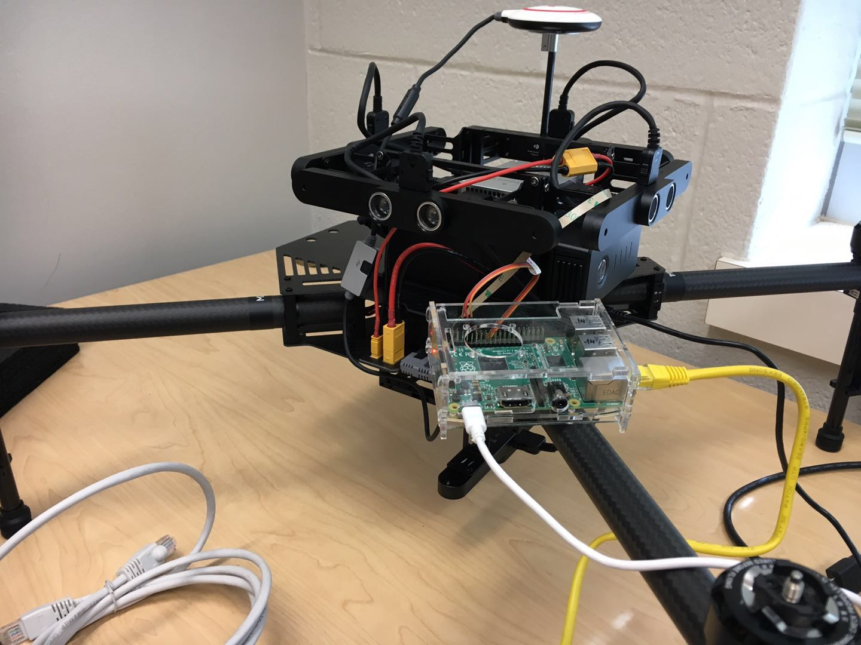
Progress 2:
Prepare the c++coding in linux system
Connect the RX, TX, GND pin to the UART port on m100

Slide 11
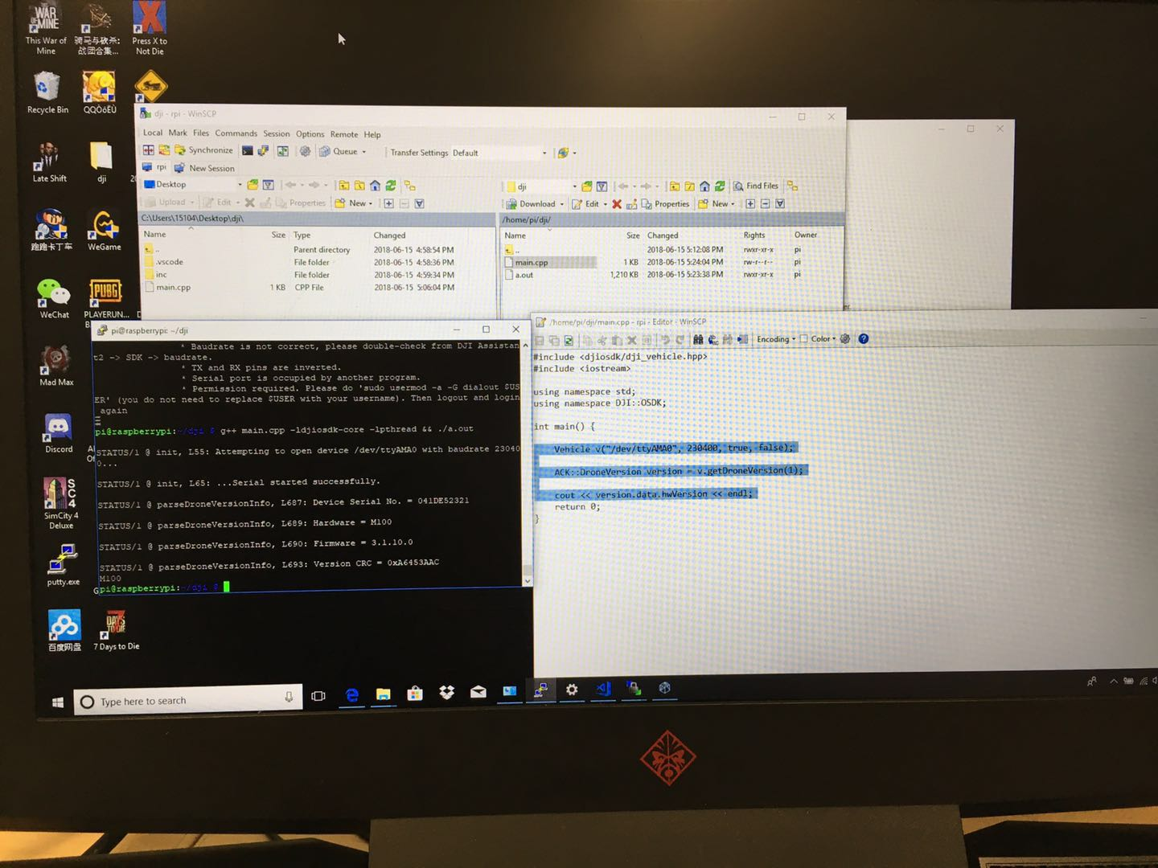
Progress 3:
Prepare the c++coding in linux system
Upload to onboard SDK
Observe the Raspberry, we can find the drone send its information back to board.

Slide 12
Summary
In the last two weeks, there are two labs to verify the possibility of communication between mobile, raspberry and drone. They can achieve send order to the drone from raspberry and mobile separately.

Slide 13
Future Plan
In the next two weeks, try to build communications between raspberry Pi and the guidance. Also, learning Linux and how to use other orders is the next hardest part, because programming needs to learn much basic computer science knowledge

